Slide 1
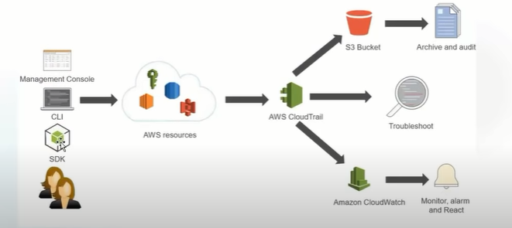
Cloud Trail

Slide 2
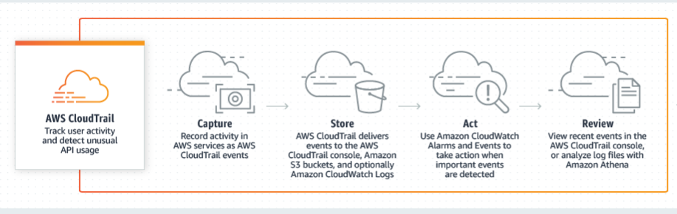
Cloud trail

Slide 3
Cloud trail includes
The recorded information includes:
The identity of the API caller
The time of the API call
The source IP address of the API caller
The request parameters
The response returned by AWS service

Slide 4
Events
Management events
- Read
- Write
Data Events
- S3
- Lambda

Slide 5
Clodtrail to clodwatch
Log groups
Alarms

